Slide 1
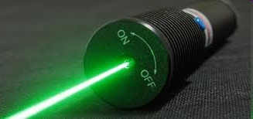
Semiconductor and optoelectronics
Prof.V.Krishnakumar Professor and Head Department of Physics Periyar University Salem – 636 011
India

Slide 2
Electricity
Electricity is the flow of electrons
Good conductors (copper) have easily released electrons that drift within the metal
Under influence of electric field, electrons flow in a current
– magnitude of current depends on magnitude
of voltage applied to circuit, and the
resistance in the path of the circuit
Current flow governed by Ohm’s Law
+
V = IR
electron flow direction
-

Slide 3


Electron Bands
•
Electrons circle nucleus in defined shells
L
K
L
M
2 electrons
8 electrons
18 electrons
K
– N
32 electrons
•
Within each shell, electrons
are further grouped into subshells
s
p
d
2 electrons
6 electrons
10 electrons
– f
14 electrons
M shell
d
10
6
2
•
electrons are assigned to
shells and subshells from inside out
– Si has 14 electrons: 2 K, 8 L, 4 M
p
s

Slide 4
Electronic Materials
•
The goal of electronic materials is to generate and control the flow of an electrical current.
Electronic materials include:
Conductors: have low resistance which allows electrical current flow
Insulators: have high resistance which suppresses electrical current flow
Semiconductors: can allow or suppress electrical current flow
•

Slide 5
Conductors
Good conductors have low resistance so electrons flow through them with ease.
Best element conductors include:
Copper, silver, gold, aluminum, & nickel
Alloys are also good conductors:
Brass & steel
Good conductors can also be liquid:
Salt water

Slide 6
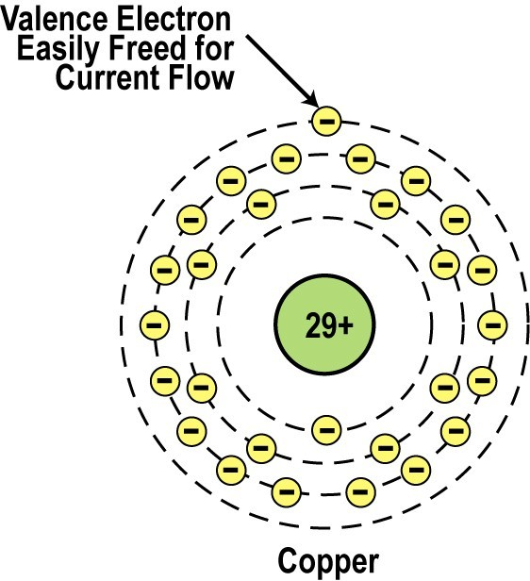
Conductor Atomic Structure
The atomic structure of good conductors usually includes only one electron in their outer shell.
It is called a valence electron.
It is easily striped from
the atom, producing current flow.
Copper Atom

Slide 7
Insulators
Insulators have a high resistance so current does not flow in them.
Good insulators include:
– Glass, ceramic, plastics, & wood
Most insulators are compounds of several elements.
The atoms are tightly bound to one another so electrons are difficult to strip away for current flow.

Slide 8
Semiconductors
Semiconductors are materials that essentially can be conditioned to act as good conductors, or good insulators, or any thing in between.
Common elements such as carbon, silicon, and germanium are semiconductors.
Silicon is the best and most widely used semiconductor.

Slide 9
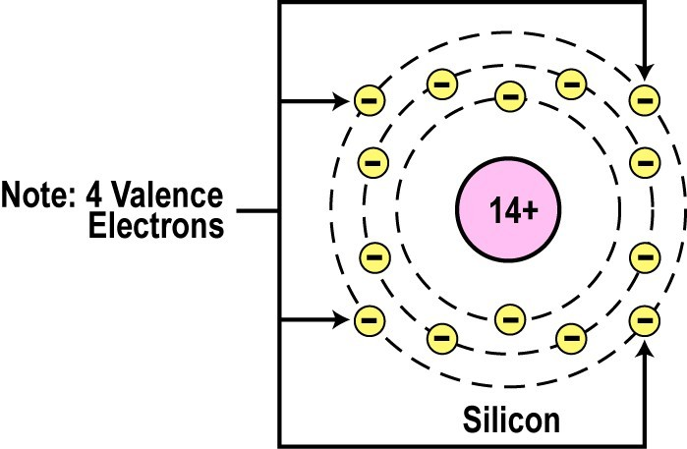
Semiconductor Valence Orbit
The main characteristic of a semiconductor element is that it has four electrons in its outer or valence orbit.

Slide 10
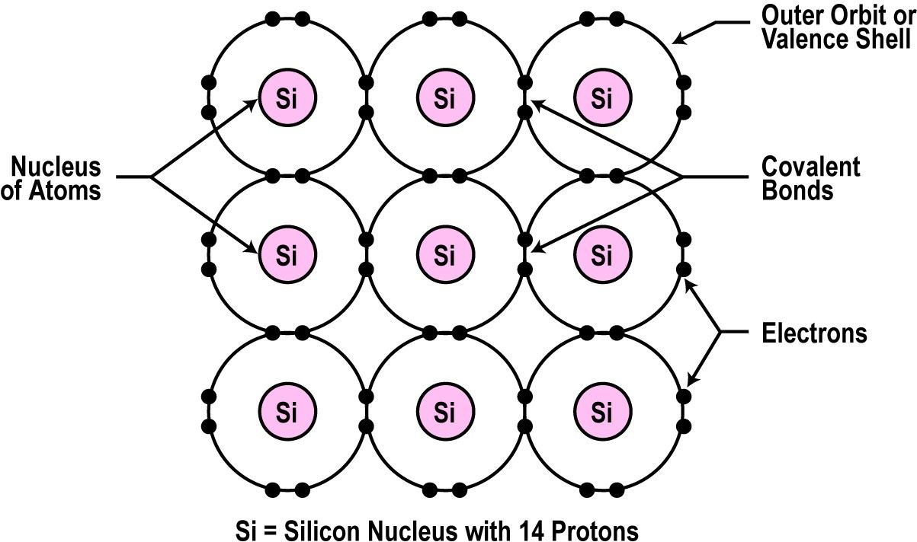
Crystal Lattice Structure
The unique capability of semiconductor atoms is their ability to link together to form a physical structure called a crystal lattice.
The atoms link together
with one another
outer
sharing their
electrons.
2D Crystal Lattice Structure
These links are called covalent bonds.

Slide 11
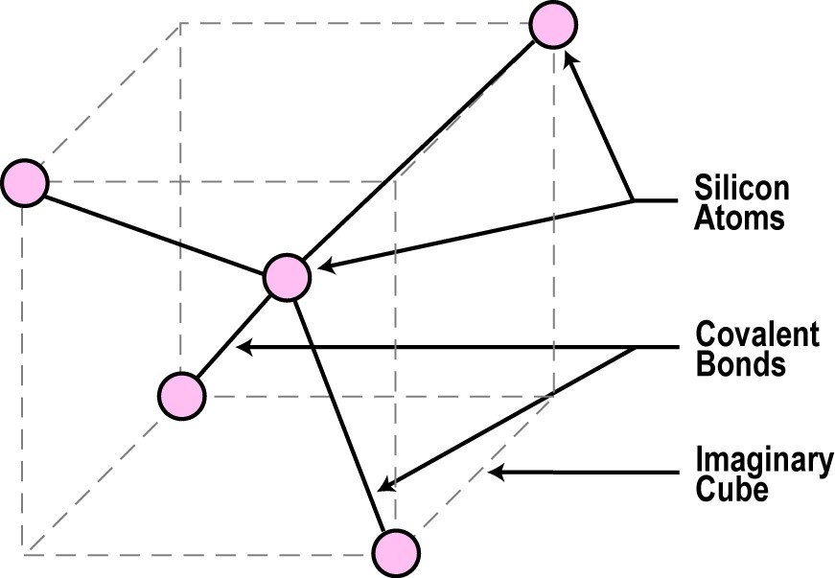
3D Crystal Lattice Structure

Slide 12
Semiconductors can be Insulators
If the material is pure semiconductor material like silicon, the crystal lattice structure forms an excellent insulator since all the atoms are bound to one another and are not free for current flow.
Good insulating semiconductor material is referred to as intrinsic.
Since the outer valence electrons of each atom are tightly bound together with one another, the electrons are difficult to dislodge for current flow.
Silicon in this form is a great insulator.
Semiconductor material is often used as an insulator.

Slide 13
Doping
To make the semiconductor conduct electricity, other atoms called impurities must be added.
“Impurities” are different elements.
This process is called doping.

Slide 14
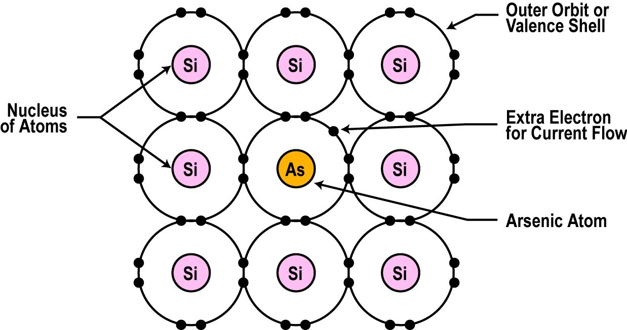
Semiconductors can be Conductors
An impurity, or element like arsenic, has 5 valence electrons.
Adding arsenic (doping) will allow four of the arsenic valence electrons to bond with the neighboring silicon atoms.
The one electron left over for each arsenic atom becomes available to conduct current flow.
•
•

Slide 15
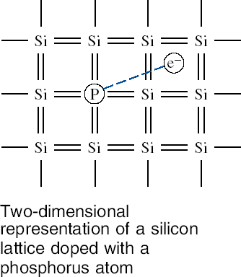
N-Type Semiconductor
The silicon doped with extra electrons is called an “N type” semiconductor.
“N” is for negative, which is the charge of an electron.

Slide 16
Resistance Effects of Doping
If you use lots of arsenic atoms for doping, there will be lots of extra electrons so the resistance of the material will be low and current will flow freely.
If you use only a few boron atoms, there will be fewer free electrons so the resistance will be high and less current will flow.
By controlling the doping amount, virtually any resistance can be achieved.

Slide 17
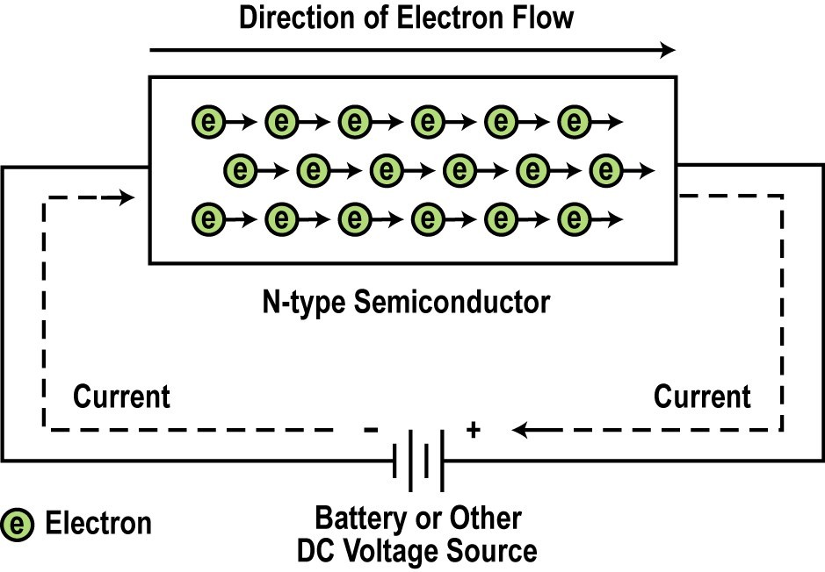
Current Flow in N-type Semiconductors
•
The DC voltage source has a positive terminal that attracts the free electrons in the
semiconductor and pulls them away from their atoms
leaving the atoms charged positively.
Electrons from the negative terminal of the supply enter the semiconductor material and are attracted by the positive charge of the atoms
•
missing one of their electrons.
•
Current (electrons) flows from the positive terminal to the negative terminal.

Slide 18
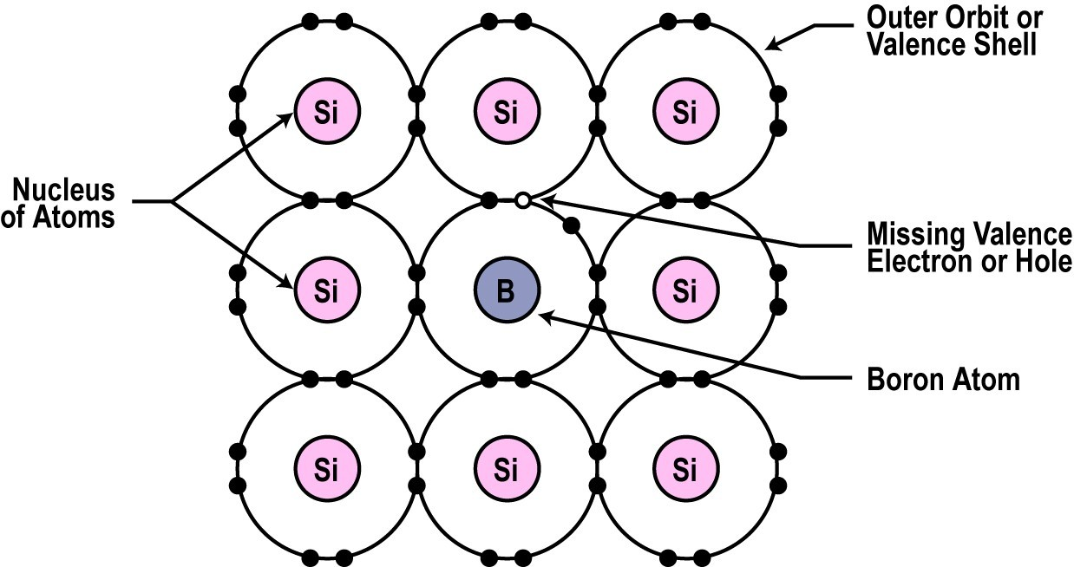
Another Way to Dope
•
You can also dope a semiconductor material with an atom such as boron that has only 3 valence electrons.
The 3 electrons in the outer orbit do form covalent bonds with its neighboring semiconductor atoms as before. But one electron is missing from the bond.
This place where a fourth electron should be is referred to as a hole.
The hole assumes a positive charge so it can attract electrons from some other source.
Holes become a type of current carrier like the electron to support current flow.
•
•
•
•

Slide 19
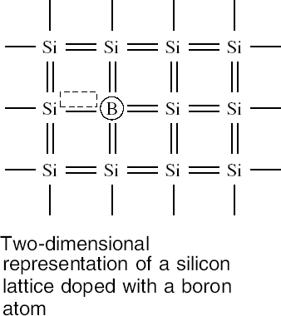
P-Type Semiconductor
Silicon material
doped with
missing
electrons that produce locations called holes is called “P type” semiconductor.
“P” is for positive, which is the charge of a hole.

Slide 20
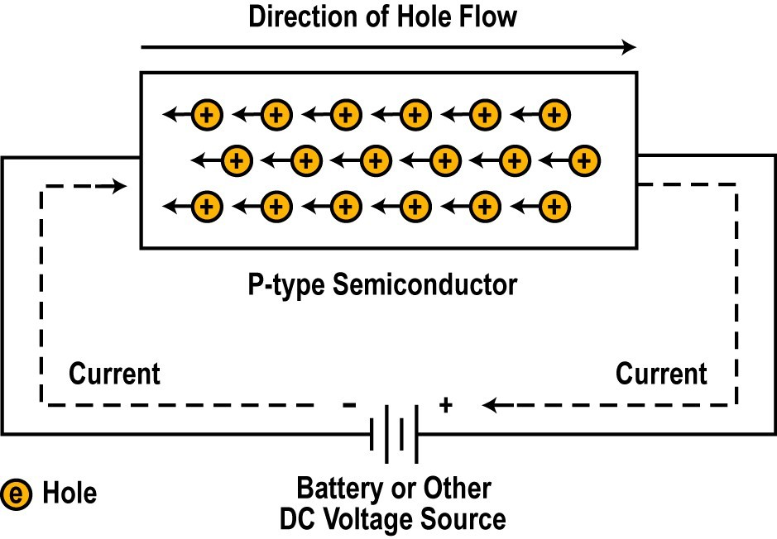
Current Flow in P-type Semiconductors
•
Electrons from the negative supply terminal are attracted to the positive holes and fill them.
•
The positive terminal of the supply pulls the electrons from the holes leaving the holes to attract more electrons.
•
Current (electrons) flows from the negative terminal to the positive terminal.
•
Inside the semiconductor current flow is actually by the movement of the holes from positive to negative.

Slide 21

Introduction to Semiconductor Devices
Semiconductor p-n junction diodes
p
n

Slide 22


p-n junction formation
p-type material
Semiconductor material doped with acceptors.
Material has high hole concentration
Concentration of free electrons in p-type material is very low.
n-type material
Semiconductor material doped with donors.
Material has high concentration of free electrons.
Concentration of holes in n-type material is very low.

Slide 23
p-n junction formation
p-type material
Contains NEGATIVELY
charged acceptors (immovable) and POSITIVELY charged holes (free).
Total charge = 0
n-type material
Contains POSITIVELY charged donors (immovable) and NEGATIVELY
charged free electrons.
Total charge = 0

Slide 24
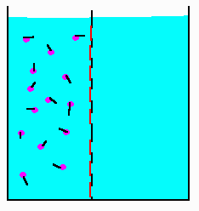
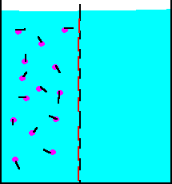
Diffusion
A substance, the purple dots, in solution. A membrane prevents movement of the water and the molecules from crossing from one side of the beaker to the other.
Now that the gates have been opened, the random movements of the molecules have caused, overtime, the number of molecules to be equal on the two sides of the barrier.

Slide 25
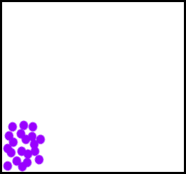
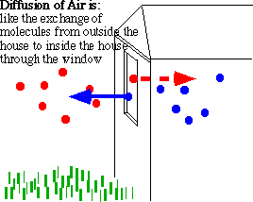
Diffusion
As a result of diffusion, the molecules or other free particles distribute uniformly over the entire volume

Slide 26
p- n junction formation
What happens if n- and p-type materials are in close contact?
Being free particles, electrons start diffusing from n-type material into p-material
Being free particles, holes, too, start diffusing from p-type material into n-material
Have they been NEUTRAL particles, eventually all the free electrons and holes had uniformly distributed over the entire compound crystal.
However, every electrons transfers a negative charge (-q) onto the p- side and also leaves an uncompensated (+q) charge of the donor on the n-side.
Every hole creates one positive charge (q) on the n-side and (-q) on the p-side

Slide 27
p- n junction formation
What happens if n- and p-type materials are in close contact?
p-type
n-type
Electrons and holes remain staying close to the p-n junction because negative and positive charges attract each other.
Negative charge stops electrons from further diffusion
Positive charge stops holes from further diffusion
The diffusion forms a dipole charge layer at the p-n junction interface.
There is a “built-in” VOLTAGE at the p-n junction interface that prevents penetration of electrons into the p-side and holes into the n-side.

Slide 28
p- n junction current – voltage characteristics
What happens when the voltage is applied to a p-n junction?
p-type
n-type
The polarity shown, attracts holes to the left and electrons to the right.
According to the current continuity law, the current can only flow if all the charged particles move forming a closed loop
However, there are very few holes in n-type material and there are very few electrons in the p-type material.
There are very few carriers available to support the current through the junction plane
For the voltage polarity shown, the current is nearly zero

Slide 29
p- n junction current – voltage characteristics
What happens if voltage of opposite polarity is applied to a p-n junction?
p-type
n-type
The polarity shown, attracts electrons to the left and holes to the right.
There are plenty of electrons in the n-type material and plenty of holes in the p-type material.
There are a lot of carriers available to cross the junction.
When the voltage applied is lower than the built-in voltage, the current is still nearly zero
When the voltage exceeds the built-in voltage, the current can flow through the p-n junction

Slide 30
Diode current – voltage (I-V) characteristics
Semiconductor diode consists of a p-n junction with two contacts attached to the p- and n- sides
p
n
V
0
⎡
⎛ qV ⎞₋ ⎤
I = I
⎢
exp
⎜ ⎟
1⎥
S
kT
⎝ ⎠
⎣ ⎦
I_{S} is usually a very small current, I_{S} ≈ 10⁻¹⁷ …10⁻¹³ A
When the voltage V is negative (“reverse” polarity) the exponential term ≈ -1; The diode current is ≈ I_{S} ( very small).
When the voltage V is positive (“forward” polarity) the exponential term increases rapidly with V and the current is high.

Slide 31

p- n diode applications: Light emitters
+
P-n junction can emit the light when forward biased
-
p-type
n-type
Electrons drift into p-material and find plenty of holes there. They “RECOMBINE” by filling up the “empty” positions.
Holes drift into n-material and find plenty of electrons there. They also “RECOMBINE” by filling up the “empty” positions.
The energy released in the process of “annihilation” produces PHOTONS – the particles of light

Slide 32
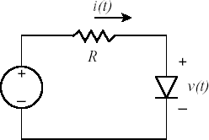

p- n diode applications: Photodetectors
-
P-n junction can detect light when reverse biased
+
p-type
n-type
When the light illuminates the p-n junction, the photons energy RELEASES free electrons and holes.
They are referred to as PHOTO-ELECTRONS and PHOTO-HOLES
The applied voltage separates the photo-carriers attracting electrons toward “plus” and holes toward “minus”
As long as the light is ON, there is a current flowing through the p-n junction

Slide 33




When
the electron
falls
down
from
conduction band and fills in a hole in valence band, there is
CB
an obvious loss of
energy.
VB

Slide 34
In order to achieve a reasonable efficiency for photon emission,
CB
VB
the semiconductor must have a direct band gap.

Slide 35
For example;
Silicon is known as an indirect band-gap^{E}
material.
What this means is that
as an electron goes from the bottom of the conduction band to the top of the valence band;
CB
it must also undergo a
k
significant change in momentum.
VB

Slide 36
As we all know, whenever something changes
state, one must conserve not only energy, but also momentum.
In the case of an electron going from conduction band to the valence band in silicon, both of these things can only be conserved:
The transition also creates a quantized set of lattice vibrations,
called phonons, or "heat“ .

Slide 37
Phonons possess both energy and momentum.
Their creation upon the recombination of an electron and hole allows for complete conservation of both energy and momentum.
All of the energy which the electron gives up in going from the conduction band to the valence band (1.1 eV) ends up in phonons, which is another way of saying that the electron heats up the crystal.

Slide 38
In a class of materials called direct band-gap semiconductors;
» the transition from conduction band to valence band involves essentially no change in momentum.
» Photons, it turns out, possess a fair amount of energy ( several eV/photon in some cases ) but they have very little momentum associated with them.

Slide 39




Thus, for a direct band gap material, the excess energy of the electron-hole recombination can either be taken away as heat, or more likely, as
a photon of light.
This radiative transition then conserves energy and momentum
by giving off light whenever an electron and hole recombine.
This gives rise to (for us) a new type of device;
CB
VB
the light emitting diode (LED).

Slide 40
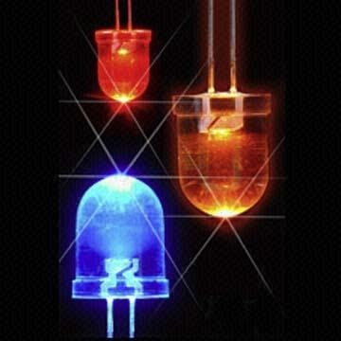
What is LED?
Semiconductors
bring quality
to light!
LED are semiconductor p-n junctions that under forward bias conditions can emit radiation by electroluminescence in the UV, visible or infrared regions of the electromagnetic spectrum. The qaunta of light energy released is approximately proportional to the band gap of the semiconductor.

Slide 41
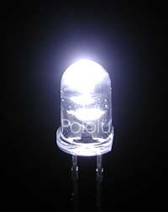
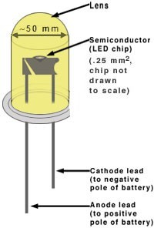
Getting to know LED
Advantages of Light Emitting Diodes ( LEDs) Longevity:
The light emitting element in a diode is a small conductor chip rather than a filament which greatly extends the diode’s life in comparison to an incandescent bulb (10 000 hours life time compared to ~1000 hours for incandescence light bulb) Efficiency:
Diodes emit almost no heat and run at very low amperes.
Greater Light Intensity:
Since each diode emits its own light Cost:
Not too bad Robustness:
Solid state component, not as fragile as incandescence light bulb

Slide 42
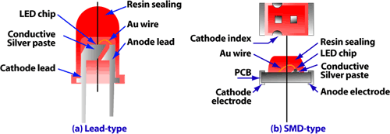
LED chip is the part that we shall deal with in this course

Slide 43
Luminescence is the process behind light emission
Luminescence is a term used to describe the emission of radiation from a solid when the solid is supplied with some form of energy.
Electroluminescence → excitation results from the application of an electric field
In a p-n junction diode injection electroluminescence occurs resulting in light emission when the junction is forward biased

Slide 44



Producing photon
Electrons recombine with holes.
_{e}-
h
CB
Energy of photon is the energy of band gap.
VB

Slide 45
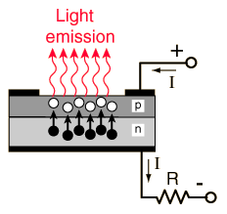
How does it work?
P-n junction
Electrical Contacts
A typical LED needs a p-n junction
There are a lot of electrons and holes at the junction due to excitations
Electrons from n need to be injected to p to promote recombination
Recombination produces light!!
Junction is biased to produce even more e-h and to inject electrons from n to p for recombination to happen

Slide 46
Injection Luminescence in LED
Under forward bias – majority carriers from both sides of the junction can cross the depletion region and entering the material at the other side.
Upon entering, the majority carriers become minority carriers
For example, electrons in n-type (majority carriers) enter the p-type to become minority carriers
The minority carriers will be larger → minority carrier injection
Minority carriers will diffuse and recombine with the majority carrier.
For example, the electrons as minority carriers in the p-region will recombine with the holes. Holes are the majority carrier in the p- region.
The recombination causes light to be emitted
Such process is termed radiative recombination.

Slide 47




MATERIALS FOR LEDS
The semiconductor bandgap energy defines the energy of the emitted photons in a LED.
To fabricate LEDs that can emit
photons from the infrared to the ultraviolet parts of the e.m.
CB
spectrum, then we must consider several different material systems.
VB
No single system can span this energy band at present, although the 3-5 nitrides come close.

Slide 48
Unfortunately, many of potentiallly useful 2-6 group of direct band-gap semiconductors (ZnSe,ZnTe,etc.) come naturally doped either p- type, or n-type, but they don’t like to be type- converted by overdoping.
The material reasons behind this are complicated and not entirely well-known.
The same problem is encountered in the 3-5 nitrides and their alloys InN, GaN, AlN, InGaN, AlGaN, and InAlGaN. The amazing thing about 3-5 nitride alloy systems is that appear to be direct gap throughout.

Slide 49
Construction of Typical LED
Al
Light output
SiO₂
p
n
Electrical contacts
Substrate

Slide 50
LED Construction
Efficient light emitter is also an efficient absorbers of radiation therefore, a shallow p-n junction required.
Active materials (n and p) will be grown on a lattice matched substrate.
The p-n junction will be forward biased with contacts made by metallisation to the upper and lower surfaces.
Ought to leave the upper part ‘clear’ so photon can escape.
The silica provides passivation/device isolation and carrier confinement

Slide 51
Efficient LED
❑
❑
❑
Need a p-n junction (preferably the same
semiconductor material only different dopants)
Recombination must occur → Radiative transmission to give out the ‘right coloured LED’ ‘Right coloured LED’ → hc/λ = E_{c}-E_{v} = E_{g}
→ so choose material with the right E_{g}
❑
❑
❑
Direct band gap semiconductors to allow efficient recombination
All photons created must be able semiconductor
Little or no reabsorption of photons
to leave the

Slide 52
Correct band gap Direct band gap
Materials Requirements
Efficient radiative pathways must exist
Material can be made p and n-type

Slide 53
UV-ED λ ~0.5-400nm E_{g} > 3.25eV
→ LED - λ ~450-650nm
E_{g} = 3.1eV to 1.6eV
→ IR-ED- λ ~750nm- 1nm
Eg = 1.65eV
Direct band gap materials
e.g. GaAs not Si
Candidate Materials
Materials with refractive index that could allow light to ‘get out’
Readily doped n or p-types

Slide 54
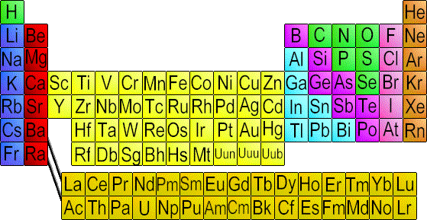
Candidate Materials Group III-V & Group II-VI
Group II Group III Group IV Group V
iii iv v
N
P
As
ii
Al
Ga In
Periodic Table to show group III-V and II-V binaries

Slide 55
Candidate Materials Group III-V & Group II-VI
Group II Group III Group IV Group V
iii iv v
N
P
As
ii
Al
Ga In

Slide 56
Semiconductor Composition
Color Name
Wavelength (Nanometers)
Infrared | 880 | GaAlAs/GaAs
Ultra Red | 660 | GaAlAs/GaAlAs
Super Red | 633 | AlGaInP
Super Orange | 612 | AlGaInP
Orange | 605 | GaAsP/GaP
Yellow Incandescent White | 585 4500K (CT) | GaAsP/GaP InGaN/SiC
Pale White | 6500K (CT) | InGaN/SiC
Cool White | 8000K (CT) | InGaN/SiC
Pure Green | 555 | GaP/GaP
Super Blue | 470 | GaN/SiC
Blue Violet | 430 | GaN/SiC
Ultraviolet | 395 | InGaN/SiC

Slide 57
Getting to know LED
Advantages of Light Emitting Diodes ( LEDs) Longevity:
The light emitting element in a diode is a small conductor chip rather than a filament which greatly extends the diode’s life in comparison to an incandescent bulb (10 000 hours life time compared to ~1000 hours for incandescence light bulb)
Efficiency:
Diodes emit almost no heat and run at very low amperes.
Greater Light Intensity:
Since each diode emits its own light Cost:
Not too bad Robustness:
Solid state component, not as fragile as incandescence light bulb

Slide 58
LED chip is the part that we shall deal with in this course

Slide 59
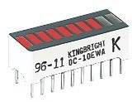
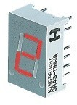
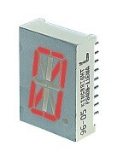
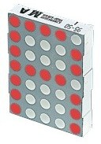

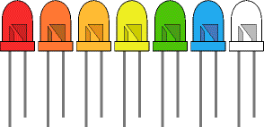

Some Types of LEDs
Bargraph
7-segment
Starburst
Dot matrix

Slide 60
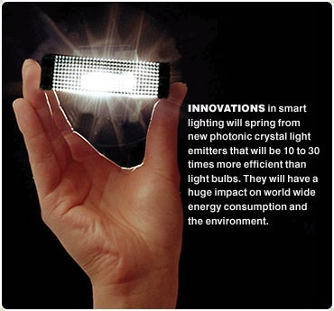

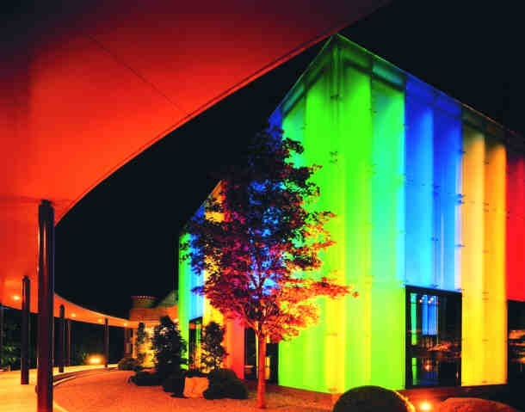

Applications of LEDs

Slide 61
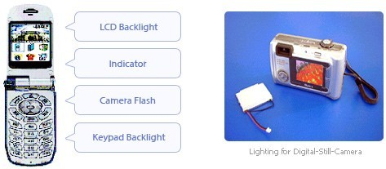
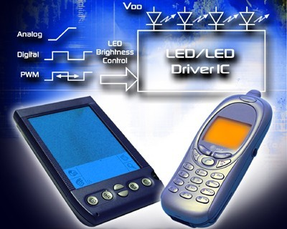
Your fancy telephone, i-pod, palm pilot and digital camera

Slide 62
Diode laser

Slide 63
What is the word LASER stands for?
Light amplification by Stimulated Emission of Radiation

Slide 64



Stimulated Emission
E₂ E₂
E₂
hυ
hυ
hυ
hυ
In
Out
hυ
E₁
E₁
E₁
(a) Absorption (b) Spontaneous emission (c) Stimulated emission
In stimulated emission, an incoming photon with energy hυ stimulates the emission process by inducing electrons in E₂ to transit down to E_{1.}
While moving down to E₁, photon of the same energy hυ will be emitted
Resulting in 2 photons coming out of the system
Photons are amplified – one incoming photon resulting in two photons coming out.
Absorption, spontaneous (random photon) emission and stimulated emission.
© 1999 S.O. Kasap, Optoelectronics (Prentice Hall)

Slide 65
Population Inversion
N₂> N₁
More atoms here
•
Non equilibrium distribution of
atoms among the various
energy level atomic system
To induce more atoms in E₂, i.e. to create population inversion,
N₂
E₂
N₁
E
a large amount of energy is required to excite atoms to E₂
The excitation process of atoms so N₂ > N₂ is called pumping
It is difficult to attain pumping when using two-level-system.
Require 3-level system instead
1
There level system
•
E₃
E₂
•
•
E₁

Slide 66





Principles of Laser
hυ₃₂
E
E
3
E
E
3
3
3
hυ₁₃
E
E
2
E
E
Metastable state
2
2
IN
2
OUT
hυ
21
hυ
21
E
E
1
E
E
Coherent photons
1
1
1
(a)
(b)
(c)
(d)
In actual case, excite atoms from E₁ to E₃.
Exciting atoms from E₁ to E₃→ optical pumping
Atoms from E₃ decays rapidly to E₂ emitting hυ₃
If E₂ is a long lived state, atoms from E₂ will not decay to E₁ rapidly
Condition where there are a lot of atoms in E₂ →population inversion achieved! i.e. between E₂ and E₁.
.

Slide 67
Coherent Photons Production (explanation of (d))
When one atom in E₂ decays spontaneously, a random photon resulted which will induce stimulated photon from the neighbouring atoms
The photons from the neighbouring atoms will stimulate their neighbours and form avalanche of photons.
Large collection of coherent photons resulted.

Slide 68
Laser Diode Principle
Consider a p-n junction
In order to design a laser diode, the p-n junction must be
heavily doped.
In other word, the p and n materials must be degenerately doped
By degenerated doping, the Fermi level of the n-side will lies in the conduction band whereas the Fermi level in the p-region will lie in the valance band.

Slide 69
Diode Laser Operation
p +
Junction
n +
E
c
E
_{p} +
n +
g
eV
E
c
E
o
Fn
Inversion
E
E
v Holes in VB
E
region
c
E
E
g
eV
Fp
Electrons
Electrons in CB
E
Fn
c
E
Fp
E
v
( a)
( b)
P-n junction must be degenerately doped.
Fermi level in valance band (p) and conduction band (n).
No bias, built n potential; eV_{o} barrier to stop electron and holes movement
V
Forward bias, eV> E_{g}
Built in potential diminished to zero
Electrons and holes can diffuse to the space charge layer

Slide 70
Application of Forward Bias
Suppose that the degenerately doped p-n junction is forward biased by a voltage greater than the band gap; eV > E_{g}
The separation between E_{Fn} and E_{Fp} is now the applied potential energy
The applied voltage diminished the built-in potential barrier, eV_{o} to almost zero.
Electrons can now flow to the p-side
Holes can now flow to the n-side

Slide 71

Population Inversion in Diode Laser
Energy
Optical gain
CB
^{E}Fn ^{− E}Fp
^{E}Fn
E_{c}
Electrons in CB
eV
0
hυ
E_{g}
E_{v}
Holes in VB
= Empty states
E
At T > 0
At T = 0
Fp
VB
Optical absorption
Density of states
(a)
(b)
(a) The density of states and energy distribution of electrons and holes in the conduction and valence bands respectively at T ≈ 0 in the SCL under forward bias such that E_{Fn} − E_{Fp} > E_{g}. Holes in the VB are empty states. (b) Gain vs. photon energy.
© 1999 S.O. Kasap, Optoelectronics (Prentice Hall)

Slide 72



Population Inversion in Diode Laser
More electrons in the conduction band near E_{C}
CB
^{E}Fn
Electrons in CB
eV
E_{g}
Than electrons in the valance band near E_{V}
Holes in VB
E
Fp
VB
E_{Fn}-E_{fP} = eV
eV > E_{g}
eV = forward bias voltage
Fwd Diode current pumping →
injection pumping
There is therefore a population inversion between energies near E_{C} and near E_{V} around the junction.
This only achieved when degenerately doped p-n junction is forward bias with energy > E_{gap}

Slide 73
The Lasing Action
The population inversion region is a layer along the junction → also call inversion layer or active region
Now consider a photon with E = E_{g}
Obviously this photon can not excite electrons from E_{V} since there is NO electrons there
However the photon CAN STIMULATE electron to fall down from CB to VB.
Therefore, the incoming photon stimulates emission than absorption
The active region is then said to have ‘optical gain’ since the incoming photon has the ability to cause emission rather than being absorbed.

Slide 74
Pumping Mechanism in Laser Diode
It is obvious that the population inversion between energies near E_{C} and those near E_{V}
occurs by injection of large charge carrier across the junction by forward biasing the junction.
Therefore the pumping mechanism is FORWARD DIODE CURRENT → Injection pumping

Slide 75
For Successful Lasing Action:
Optical Gain (not absorb)
Achieved by population inversion
Optical Feedback
Achieved by device configuration
Needed to increase the total optical amplification by making photons pass through the gain region multiple times
Insert 2 mirrors at each end of laser
This is term an oscillator cavity or Fabry Perot cavity Mirrors are partly transmitted and party reflected

Slide 76
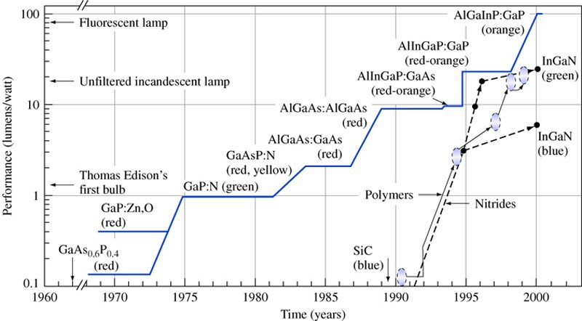
Materials for Laser Diodes

Slide 77
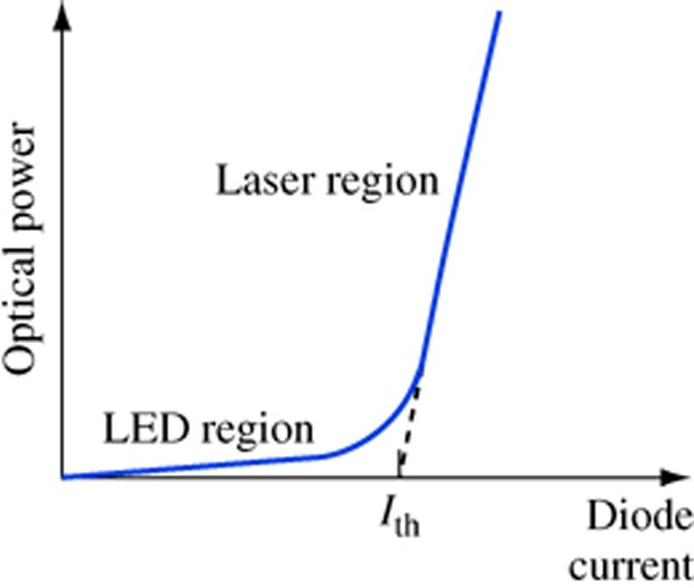
Optical Power in Laser is Very High due to Optical Feedback and Higher Forward Bias Current.
Threshold current density

Slide 78
Direct Gap Diode Laser
Direct band gap → high probability of electrons- holes recombination → radioactively
The recombination radiation may interact with the holes in the valance band and being absorbed or interact with the electrons in the conduction band thereby stimulating the production of further photons of the same frequency → stimulated emission

Slide 79
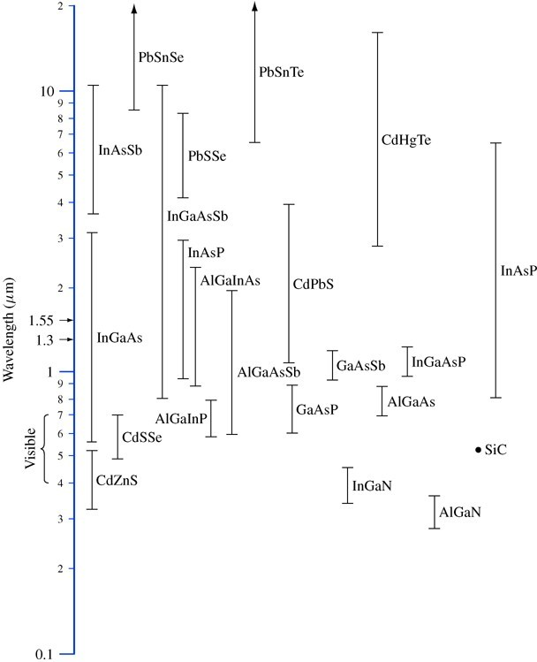
Materials Available

Slide 80
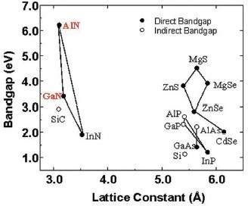
Technologically Important Material for Blue Laser

Slide 81
InGaN and AlGaN
•
InGaN and AlGaN have been produced over the entire composition range between their component binaries; InN, GaN, AlN
InAlN is less explored.
GaN and AlN are fairly well lattice-matched to SiC substrates,
SiC has substrate is better as it can be doped (dopability) and high thermal conductivity relative to more commonly used Al₂O₃ substrates.
AlN and GaN can be used for high temperature application due to wide bandgaps and low intrinsic carrier concentrations.
•
•
•
•

Slide 82

Laser sword

